Slide 1
MORTALITY REVIEW MEET

Slide 2
3 DEPARTMENTS – GENERAL MEDICINE, 2- CARDIOLOGY

Slide 3
1ST CASE
General Medicine

Slide 4
69 Years old
Female patient
Informant : Son
Date of admission : 15/02/2021 at 1:51 AM
Date of death : 21/02/2021 at 07:53 AM
Duration of hospital stay : 6 days 5 hours
Place of death : GICU

Slide 5
HISTORY OF PRESENT ILLNESS
H/o loss of consciousness since afternoon ( 1 PM 14/02/21)
H/o shortness of breath since morning , acute onset, grade 4 NYHA ,
associated with orthopnea
H/o swelling of both lower limbs associated with facial puffiness
from 2 days
H/o decreased urine output from 2 days
H/o vomitings from 2 days ( 3 episodes/day) , non-bilious, watery in
consistency

Slide 6
No h/o fever, cough, burning micturition, abdominal pain
No h/o myalgia , arthralgia, diarrhoea
No h/o headache, blurring of vision, trauma
No h/o slurred speech , weakness of limbs.

Slide 7
PAST HISTORY
Known case of COPD from 3 years, not on medication
Known case of CAD with severe MR with moderate PAH from 3 years , on irregular medication.
Not a k/c/o DM , HTN, PTB, Epilepsy, Thyroid abnormality

Slide 8
On arrival to ER, patient was intubated outside , on mechanical ventilation in view of airway compromise . (E₁V_{T}M₁)

Slide 9
GENERAL EXAMINATION
Patient was on sedation.
Patient was on mechanical ventilation , SIMV(PC) mode with FiO₂-100 %
PEEP – 6cm H₂O , RR- 15cycles/min
Pallor present
Pitting pedal edema of both limbs present
No icterus, clubbing, cyanosis, lymphadenopathy

Slide 10
VITALS
Pulse rate – 96 bpm
Blood Pressure-80/50 mm of Hg, started on Inj. Noradrenaline @ 5ml/hr
RR – 15 cycles / min
Temperature – 98 F
SpO₂ – 99 % with FiO₂- 100%
CBG – 167 mg/dl

Slide 11
SYSTEMIC EXAMINATION
CVS- S1 and S2 heard . Loud S1
Systolic murmur heard in mitral area
RS – Bilateral normal vesicular breath sounds heard
Bilateral basal crepitations heard
CNS- Patient was sedated and paralysed
GCS – E₁V_{T}M₁
Pupil – 2mm, reacting to light ( left eye ) .. Right eye operated
for cataract
P/A – soft , no organomegaly, bowel sounds normal

Slide 12
Investigations (15/02/21)
Hb - 3.8g/dl
TLC – 21,200 cells/cumm
Neutrophils- 95%
Platelet count – 1.5 lac/cumm
RBC Count – 2.2 million/cum
PCV- 14 vol%
MCV- 63 Fl
S. Ferritin – 36.58 ng/ml
LDH - 931
CRP- 18mg/dl

Slide 13
T₃ – 0.65 ng/ml
T₄ – 7.62 mcg/dl
TSH- 3 Miu/ml
S.Na – 134 meq/L
S.K⁺ - 3.9 meq/L
S.CI – 89 meq/L
Mg – 1.9mg/dl
Ca+2 – 8.73mg/dl
S.Urea – 38mg/dl
S.Cr – 2.15mg/dl

Slide 14
PT – 26.7 sec
INR – 2.12
APTT- 51.1 sec
HbA_{1c} – 5.7 %
CUE
Albumin- 2+
Pus cells – plenty
RBC – plenty
Bacteria- present
HRCT – No obvious ground glass opacities.
Cardiomegaly with minimal bilateral pleural effusion

Slide 15
S. Total bilirubin – 1.24mg/dl
Direct bilirubin – 1 mg/dl
SGOT – 248 U/L
SGPT – 117 U/L
ALP – 296 U/L
Total protein – 6g/dl
S.Albumin – 3.4 g/dl
Blood grouping- ’O’Rh positive
Rapid antigen test for COVID 19 - Negative

Slide 16
ABG ( @admission 1 AM ) ABG ( @ 6:30 AM )
pH - 7.03 pH - 7.24
Pco₂ - 21mm Hg Pco₂ – 15 mm Hg
Lactate – 13 mmol/L Lactate – 9 mmol/L
HCO₃ – 7.1mmol/L HCO₃ – 9.9 mmol/L
Blood and urine samples sent for culture and sensitivity
2D ECHO : RWMA + RCA Territory Hypokinetic
Mild to moderate LV dysfunction
Severe MR, Minimal PE
EF – 45%

Slide 18
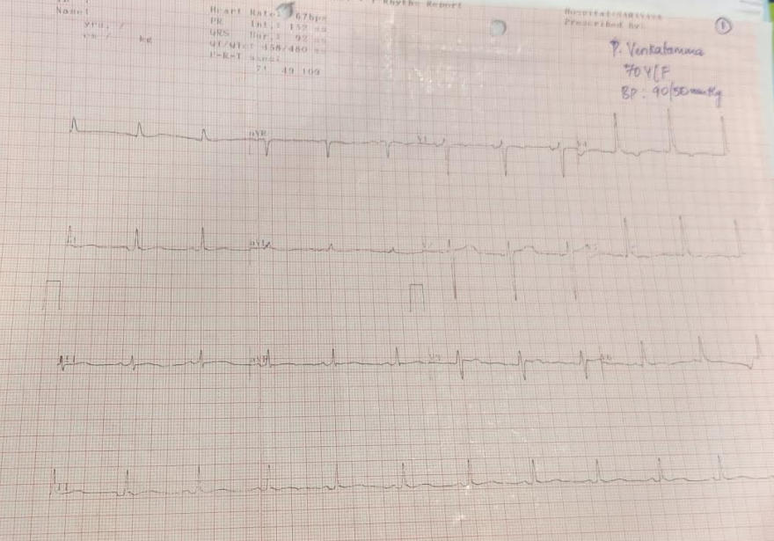

Slide 19
Provisional Diagnosis
UTI / SEPSIS / SEPTIC SHOCK
AKI/CKD , CAD, COPD
METABOLIC ENCEPHALOPATHY
IRON DEFICIENCY ANAEMIA

Slide 20
Treatment
PRBC Transfusion
Inj. MEROPENEM 500mg IV TID
Inj. NORADRENALINE @ 5ml/hr
Inj. SODIUM BICARBONATE 50 meq STAT
Inj. PANTOP 40mg IV OD
Inj. EMESET 4mg IV TID
Inj. Vit K 10mg IV OD
Inj.Vit C 1.5gm IV OD
Nebulisation – DUOLIN TID
MUCOMIX TID
Patient attendants were counselled regarding the prognosis.

Slide 21
DAY 2 ( 16/02/21)
Patient was on mechanical ventilator, sedated and paralysed
On Noradrenaline infusion @ 2ml/hr
Urine output : 15-20ml/hr
Nephrologist opinion was asked.
Inj. DOXYCYCLINE added
PRBC transfusion done
Vitals :
Pulse rate – 80bpm
Blood pressure – 100/70 m of Hg
RR – 15/min
Temperature- 98 F
SpO2- 98% with FiO2- 40%

Slide 22
Systemic Examination
CVS- S1, S2 heard , loud S1
Systolic murmur heard in mitral area
RS – B/L normal vesicular breath sounds heard
CNS- Patient was sedated and paralysed
GCS – E₁V_{T}M₁
Pupil – 2mm, reacting to light ( left eye )
P/A – soft , no palpable organomegaly
PT – 43.4 sec
INR- 3.85
APTT- 49.9 sec

Slide 23
S.K – 4.1 meq/L
S.Cl – 91 meq/L
S.Na – 140meq/L
S.Urea– 50 mg/dl
S.Creatinine- 2.41mg/dl
Hb- 5.3 gm/dl
TLC- 31,000 cells/cumm
Neutrophils – 95%
ABG : pH – 7.03
Pco2- 86mm Hg
Lactate – 1.1 mmol/L
HCO3 – 22.7 mmol/L

Slide 24
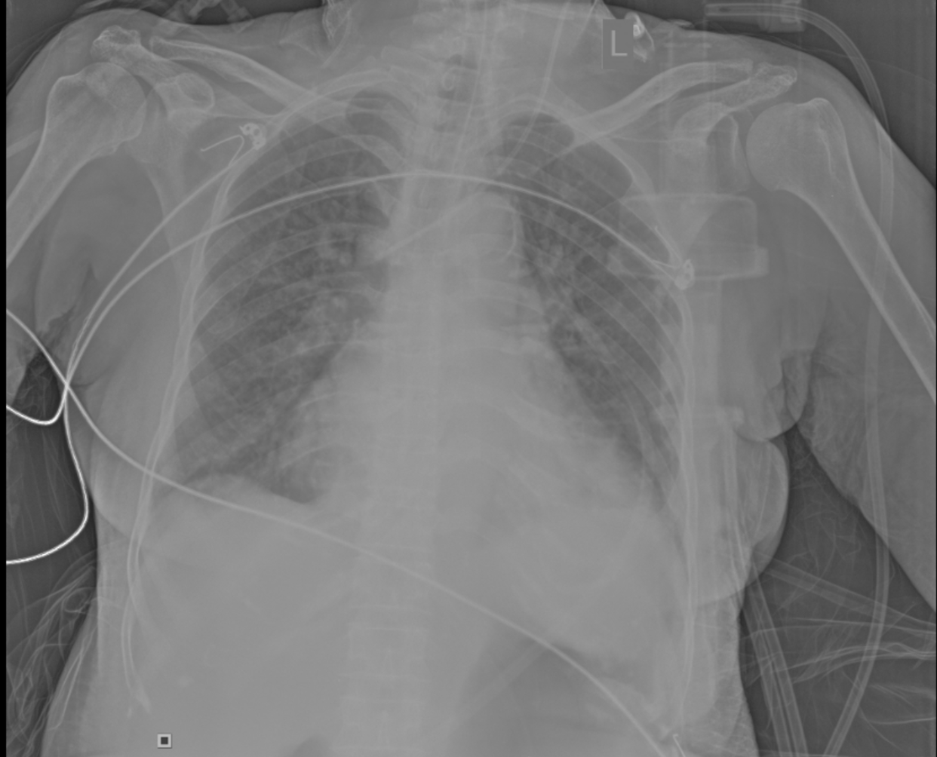

Slide 25
DAY 3 ( 17/02/21)
Patient was on mechanical ventilator, sedated and paralysed
Noradrenaline infusion was stopped
Urine output : 5-10 ml/hr
Nephrologist opinion was taken and hemodialysis done
PRBC Transfusion done
Vitals :
Pulse rate – 80bpm
Blood pressure – 100/70 m of Hg
RR – 15/min
Temperature- 98 F
SpO2- 98% with FiO2- 40%

Slide 26
Systemic Examination
CVS- S1, S2 heard , loud S1
Systolic murmur heard in mitral area
RS – B/L normal vesicular breath sounds heard
CNS- Patient was sedated and paralysed
GCS – E₁V_{T}M₁
Pupil – 2mm, reacting to light ( left eye )
P/A – soft , no organomegaly
Urine C/S – No bacterial growth after 48 hrs
PT – 15 sec
INR- 1.04
APTT- 41.1 sec

Slide 27
S.K – 4.3 meq/L
S.Cl – 98 meq/L
S.Na – 125 meq/L
S.Urea – 95 mg/dl
S.Creatinine- 2.44 mg/dl
Hb- 6.9 gm/dl
TLC- 23,700 cells/cumm
Platelet count : 1.13 lacs/cumm
Neutrophils – 96%
ABG : pH – 7.31
Pco2- 35mm Hg
Lactate – 0.8 mmol/L
HCO3 – 18.8 mmol/L
BLOOD CULTURE: No bacterial growth after 48 hours of aerobic incubation.

Slide 28
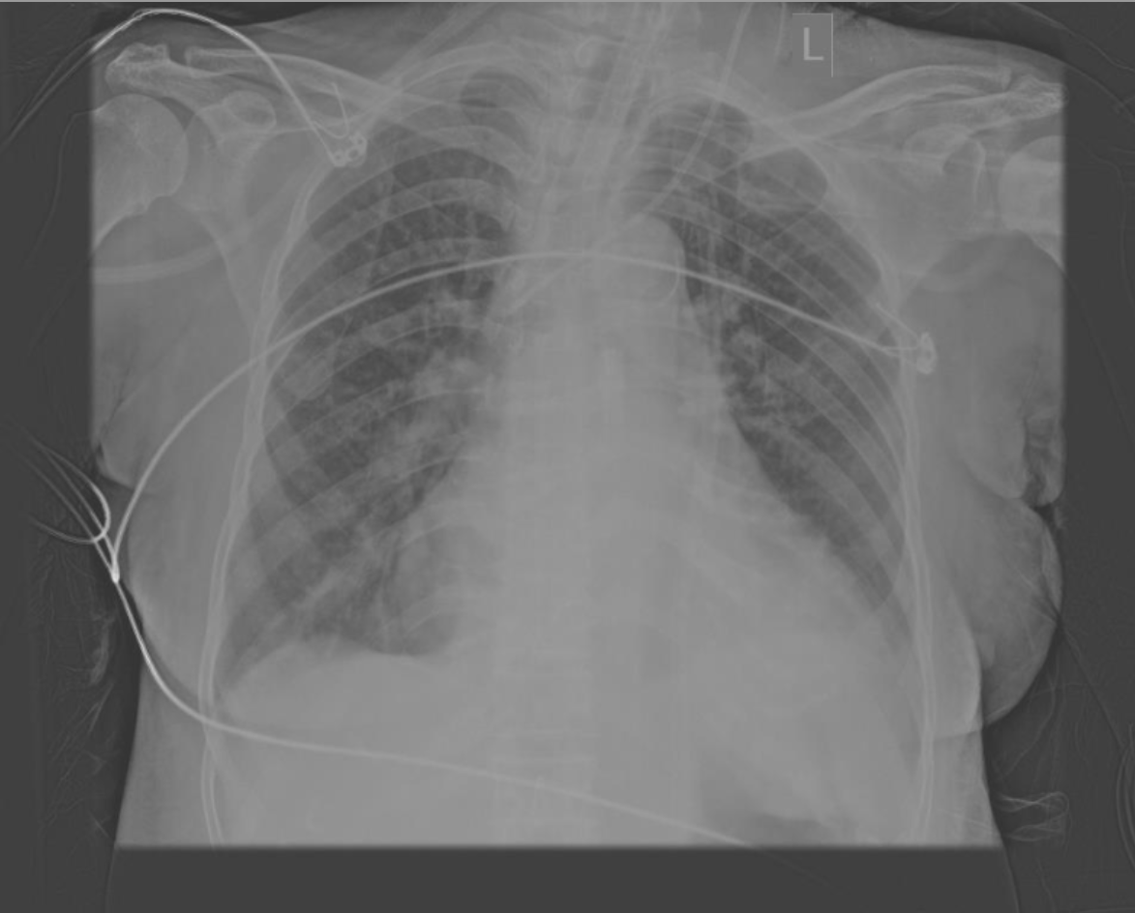

Slide 29
DAY 4 ( 18/02/21)
Patient was on mechanical ventilator, PCV mode , FiO2 – 40 % , PEEP – 5cm H₂O
Patient was in altered sensorium, responding to verbal commands.
Urine output : 15-20 ml/hr
Nephrologist review was taken and hemodialysis done
PRBC Transfusion done
Vitals :
Pulse rate – 74bpm
Blood pressure – 150/100 m of Hg
RR – 14/min
Temperature- 98 F
SpO2- 100% with FiO2- 40%

Slide 30
Systemic Examination
CVS- S1, S2 heard , loud S1
Systolic murmur heard in mitral area
RS – B/L normal vesicular breath sounds heard
CNS- Patient was in altered sensorium, responding to verbal commands.
Spontaneous movements of all limbs present.
GCS – E₃V_{T}M₄
Pupil – 1-2 mm, reacting to light ( left eye )
P/A – soft , no organomegaly
PT – 15 sec
INR – 1.04
APTT – 41.1 sec

Slide 31
S.K – 3.5 meq/L
S.Cl – 98 meq/L
S.Na – 130 meq/L
S.Urea – 64 mg/dl
S.Creatinine- 1.98 mg/dl
Hb- 7 gm/dl
TLC- 18,500 cells/cumm
Platelet count : 0.75 lacs/cumm
Neutrophils – 87%
ABG : pH – 7.32
Pco2- 35mm Hg
Lactate – 0.6 mmol/L
HCO3 – 19.2 mmol/L

Slide 32
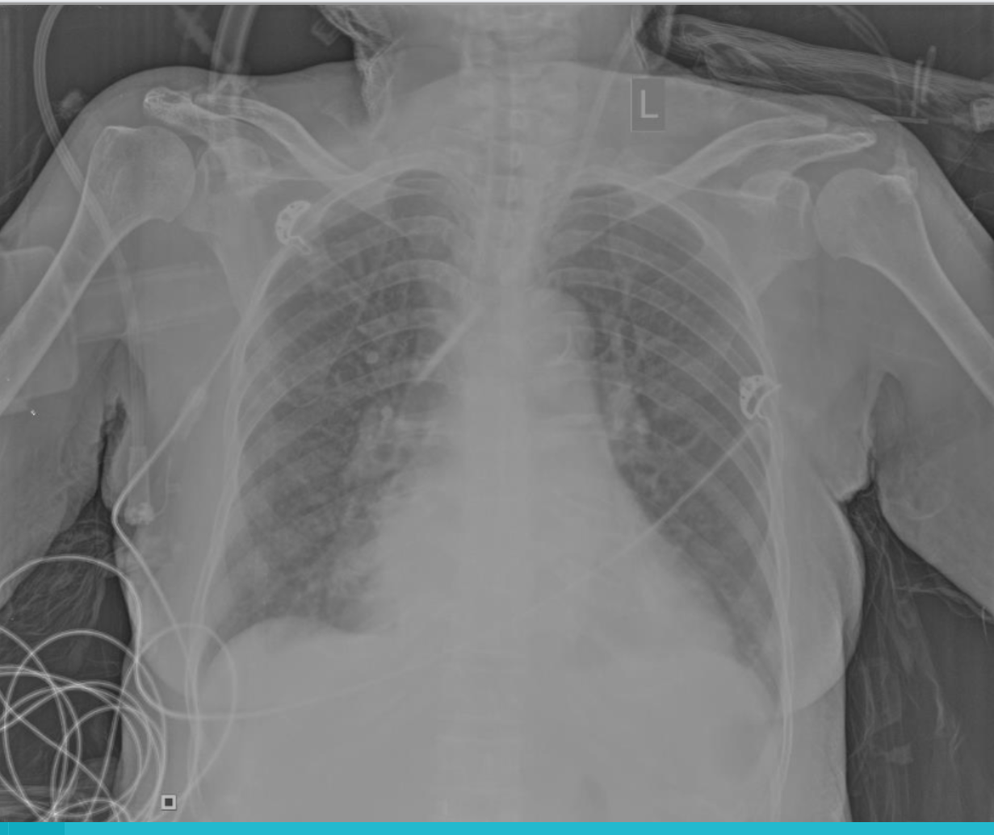

Slide 33
DAY 5 (19/02/21)
Patient was on mechanical ventilator, PCV mode , FiO2 – 50 % , PEEP – 5cm H₂O
Patient was in altered sensorium, responding to painful stimuli
Urine output : 20-25 ml/hr
Nephrologist review was done and planned for hemodialysis
4 FFPs Transfusion done
ET aspiration sent for culture and sensitivity
Vitals :
Pulse rate – 106bpm
Blood pressure – 100/60 m of Hg
RR – 14/min
Temperature- 98.6 F
SpO2- 100% with FiO2- 40%

Slide 34
Systemic Examination
CVS- S1, S2 heard , loud S1
Systolic murmur heard in mitral area
RS – B/L normal vesicular breath sounds heard
B/L Basal crepitations heard
CNS- Patient was in altered sensorium, responding to painful stimuli
GCS – E₂V_{T}M₄
Plantatrs – B/L flexor
Pupil – 1-2 mm, reacting to light ( left eye )
P/A – soft , no organomegaly

Slide 35
S.K – 3.6 meq/L
S.Cl – 96 meq/L
S.Na – 136 meq/L
S.Urea – 98.2 mg/dl
S.Creatinine- 2.77 mg/dl
Hb- 8.9 gm/dl
TLC- 7,400 cells/cumm
Platelet count : 0.6 lacs/cumm
Neutrophils – 76%
ABG : pH – 7.32
Pco2- 35mm Hg
Lactate – 1.1 mmol/L
HCO3 – 19.1 mmol/L

Slide 36
CUE
Albumin- 2+
Pus cells – 10-12
RBC – 20-22
Bacteria- present
S. Total bilirubin – 1.24mg/dl
Direct bilirubin – 0.9 mg/dl
SGOT – 67 U/L
SGPT – 95 U/L
ALP – 328 U/L
Total protein – 4.9 g/dl
S.Albumin – 2.8 g/dl
Gram staining of ET aspirate showed plenty of Gm negative cocco bacilli

Slide 37
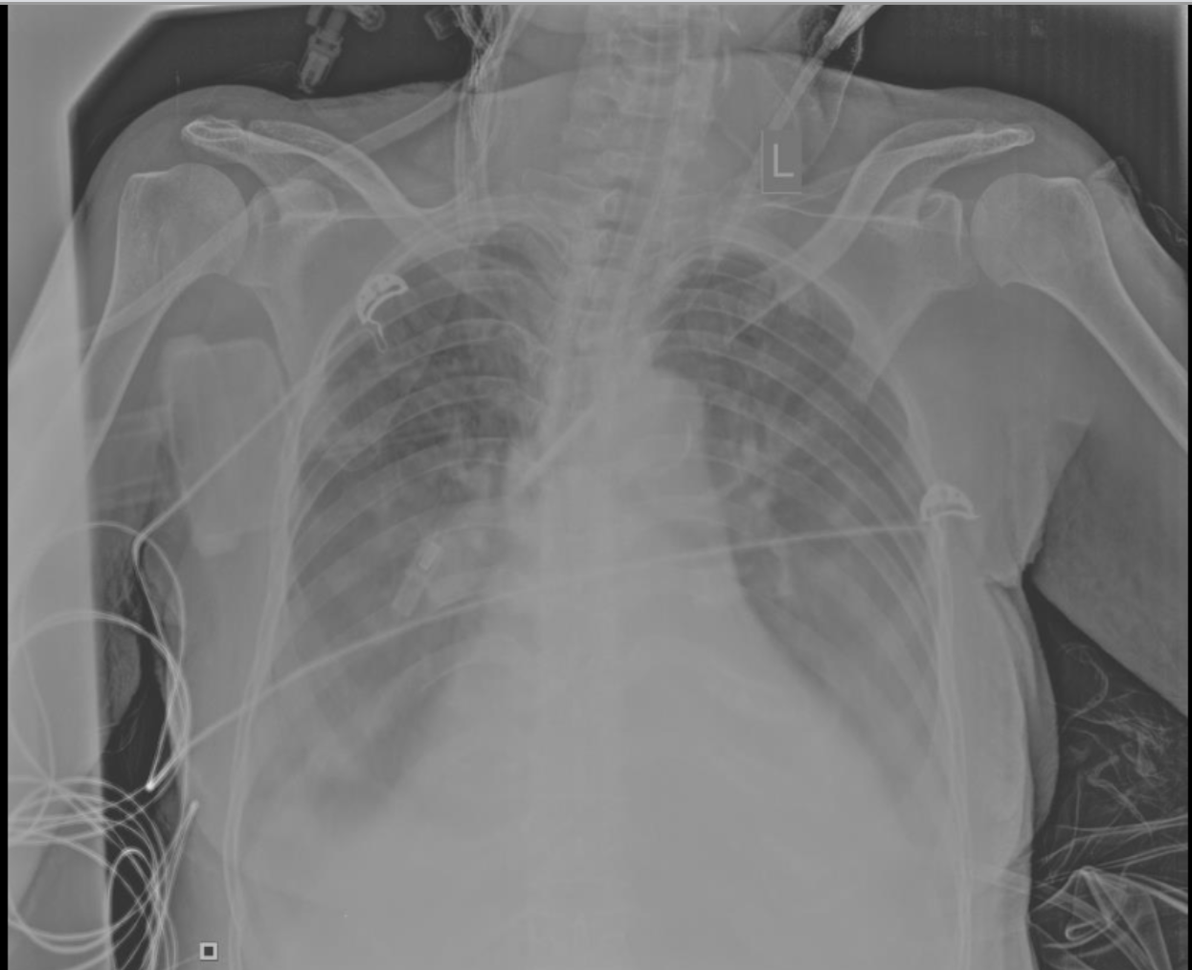

Slide 38
DAY 6 (20/02/21)
Patient was on mechanical ventilator, PRCV mode,FiO2-80 % ,PEEP- 5cm H₂O
Patient was in altered sensorium, not responding to painful stimuli.
On ionotrope support , noradrenaline @ 8ml/hr and vasopressin@ 1.2ml/hr
as BP was 80/60 mm of Hg
Urine output : 10 ml/hr
3rd hemodialysis done
Vitals :
Pulse rate – 116bpm
Blood pressure – 130/90 m of Hg
RR – 14/min
Temperature- 98.6 F
SpO2- 100% with FiO2- 40% subsequently increased to 80%

Slide 39
Systemic Examination
CVS- S1, S2 heard , loud S1
Systolic murmur heard in mitral area
RS – B/L normal vesicular breath sounds heard
B/L Basal crepitations heard
CNS- Patient was is in altered sensorium, not responding to painful stimuli
GCS – E₁V_{T}M₁
Plantars – B/L flexor
Pupil – 2 mm, reacting to light ( left eye )
P/A – soft ,organomegaly

Slide 40
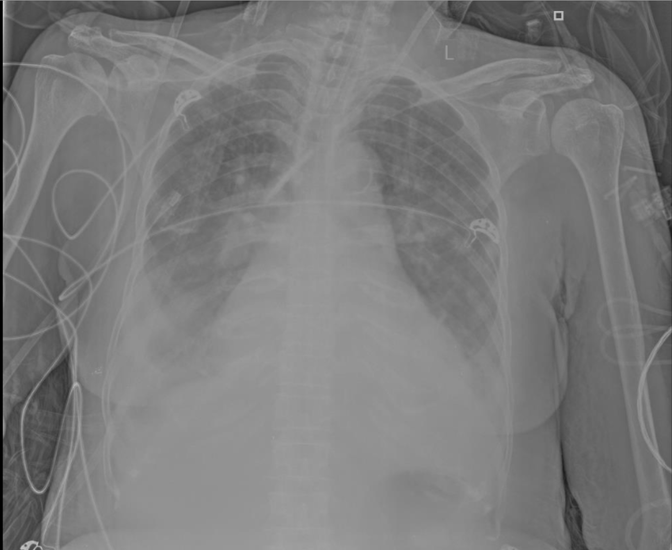

Slide 41
DAY 7 (21/02/21)
At 6:50 AM, Patient had bradycardia, pulse was not palpable, BP was unrecordable.
CPR initiated according to ACLS protocol.
Inspite of all efforts patient couldn’t be revived.
Hence declared dead on 21/02/2021 @ 7: 53 AM.

Slide 42
CAUSE OF DEATH
Immediate cause : Septic shock
Antecedent causes : Sepsis
UTI
AKI/CKD
COPD/ CAD
METABOLIC ENCEPHALOPATHY

Slide 43
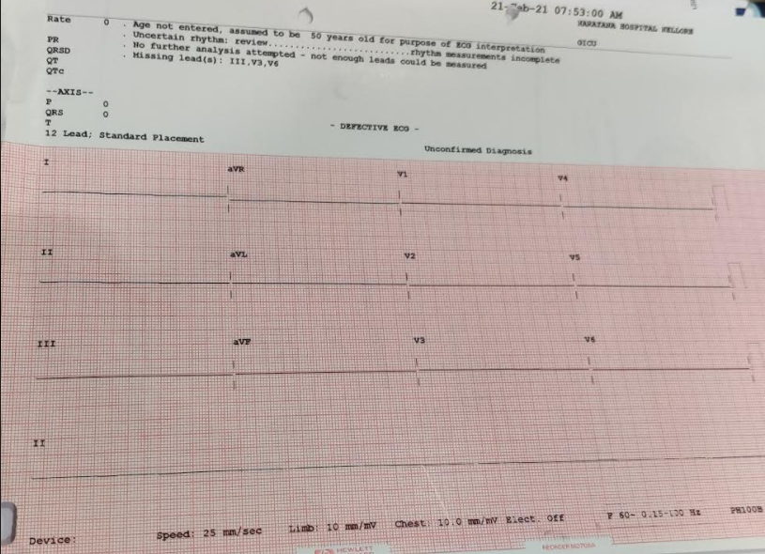

Slide 44
THANK YOU

Slide 45
2 nd case 1. Cardiology

Slide 46
MORTALITY MEET
CONSULTANT :DR REDDI BASHA
DM (CARDIOLOGY)
POST GRADUATE : DR REVANTH
DEPT OF CARDIOLOGY

Slide 47
Date of Admission:16 JAN 2021
Date of Death: 25 JAN 2021
HOSPITAL STAY : 9 DAYS

Slide 48
A 54 yr old man with H/O CAD s/p PTCA (2017), with frequent admissions for heart failures /COPD was admitted with C/O progressive difficulty in breathing which progressed from NYHA class II to class IV over 10 days assosiated with orthopnea.
He also gives H/O bilateral lower limb swelling assosiated abdominal distension since 3 days.

Slide 49
He has Pallor , pedal edema.
HR : 94 bpm
BP : 90/60 mmHg
JVP : Elevated
On auscultation he had bilateral crepts
ECG : 94 bpm regular
Incomplete RBBB with normal axis
Q IN III , AVF

Slide 51
2D ECHO
Global hypokinesia of LV
Dilated RA/RV/IVC
SEVERE TR/ NO PAH/MILD MR
TAPSE 1.3
RV DYSFUNCTION/SEVERE LV DYSFUNCTION (EF 30%)
NO PE/ NO LA,LV CLOTS

Slide 52
HB : 10.3 gm/dl
TC : 7600 / cumm
PLATELETS : 1.15 lakhs/ cumm
UREA : 199 mg/dl
CREATININE : 2.47 mg/dl
Na/k/cl : 136/5.5/102 mEq/dl
Uric acid : 11.39 mg/dl

Slide 53
LFT :
Biliubin Total : 2.28 mg/dl
direct : 1.41 mg/dl
SGOT/SGPT/ALP : 34/18/199 U/L
Total protein: 6.1 g/dl
Albumin 3.5 g/dl

Slide 54
USG ABDOMEN
MODERATE ASCITES
B/L GRADE I RENAL PARENCHYMAL CHANGES
B/L MILD PLEURAL EFFUSIONS

Slide 55
ABG
PH : 7.17
PO2 : 86 mmHg
PCO2 : 74 mmHg
HCO3 : 31 mmol/L

Slide 57
Recurrent refractory heart failure with biventricular dysfunction
Cardiogenic shock
Type II Respiratory failure
AKI

Slide 58
Pulmonologist and nephrologist consultations were taken and advice followed.
Managed with ionotropes, NIV support, diuretics, hyperkalemia measures, antibiotics,diuretic infusion, antiplatelets,statins along with other supportive measures.

Slide 59
Gastroenterologist consultation was taken for mild deranged liver parametres and ascites, for which therapeutic abdominocentesis was done to relieve respiratory distress.
Ascitic fluid analysis showed transudative picture.

Slide 60
Pt general condition improved with above line of management and was shifted to ward on 22/01/2021.
Repeat blood samples were done
Urea : 96 mg/dl
Creatinine : 1.5 mg/dl
K : 4.6 mEq/dl
Hb : 9.4 mg/dl
TC : 7600 cells/cumm

Slide 61
He developed sudden cardiac arrest on 24/01/21 from which he was revived and connected to mechanical ventillator along with ionotropes.
He had recurrent cardiac arrest at around 1.20 am on 25/01/21 and resuscitated as per ACLS guidelines, inspite of which he could not be revived and was declared dead at 1.50 am.

Slide 62
CAUSE OF DEATH
SUDDEN CARDIAC ARREST
CONGESTIVE HEART FAILURE
IHD WITH BIVENTRICULAR DYSFUNCTION
COPD WITH TYPE II RESPIRATORY FAILURE
ACUTE KIDNEY INJURY

Slide 63
3rdCASE
2.Cardiology

Slide 64
MORTALITY MEET
Asso prof : Dr Reddi Basha shaik
PG : Dr Nagabhushan
Department of Cardiology

Slide 65
Date of admission : 4/2/21
Date of death. : 11/2/21
Duration of hospital stay : 7 days

Slide 66
A 68 Year old female presented
History of Chest pain since 10 day
History of Dyspnoea since 10 day

Slide 67
History of type2 DM since 10 years taking OHs regularly.
NO History of SHTN, OLD CVA, CAD

Slide 68
On Examination
No pallor, ictyrus, cyanosis
BP : 120/70 mm of Hg
Pulse : 110 bpm
JVP : elevated
Res rate : 25 cycles/min
Spo2 :100 with o2
CVS : S1 S2 heard no murmurs
RS : NVBS, Bilateral basal crepitations present

Slide 69
ECG

Slide 70
2DECHO :
RWMA of inferior wall
Severe LVD
Severe MR, Mild AR, Mild TR, Moderate PAH
EF 30%

Slide 73
ACS – IWMI
KILLIPS CLASS ll
SEVERE MR, severe LVD
TYPE 2 DM
Anaemia

Slide 74
Patient was treated with antiplatelets, anticoagulants, statins, diuretics, insulin.
Later B Blockers and ACE inhibitors were added
Patient was stabilized and shifted to ward.

Slide 75
On 9/2/21
CAG done : Double vessel disease
ADVICE : PTCA TO RCA ( 2 STENTS)
ON 10th Patient had loose stools 10 Episodes developed hypotension for which patient was shifted to ICU and treated with iv fluids, antibiotics, inotropes
Patient developed AKI with metabolic acidosis

Slide 76
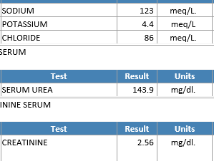

Slide 77
Nephrology opinion obtained
Patient was in respiratory distress with decreased saturation planned for elective intubation, patient attenders were not willing
Patient developed bradycardia, carotids not felt 3:00 pm

Slide 78
Patient was resuscitated as per ACLS protocol patient could not be revived back declared death on 11/2/2021 at 3:32 pm

Slide 79
Cause of Death
Cardiac Arrest secondary to Severe Metabolic acidosis
Acute Gastroeneritis, SEPSIS, SEPTIC SHOCK AKI
ACS – IWMI
Severe LVD

Slide 80
Thank you

