Slide 1
Dr. Biju Ravindran
Professor and HOD
DEPT OF ORTHOPAEDICS
NARAYANA MEDICAL COLLEGE
NELLORE

Slide 2
Bed side teaching manners and learning in hospital
Medical procedural teaching
What is professionalism
Learning to be professional

Slide 3
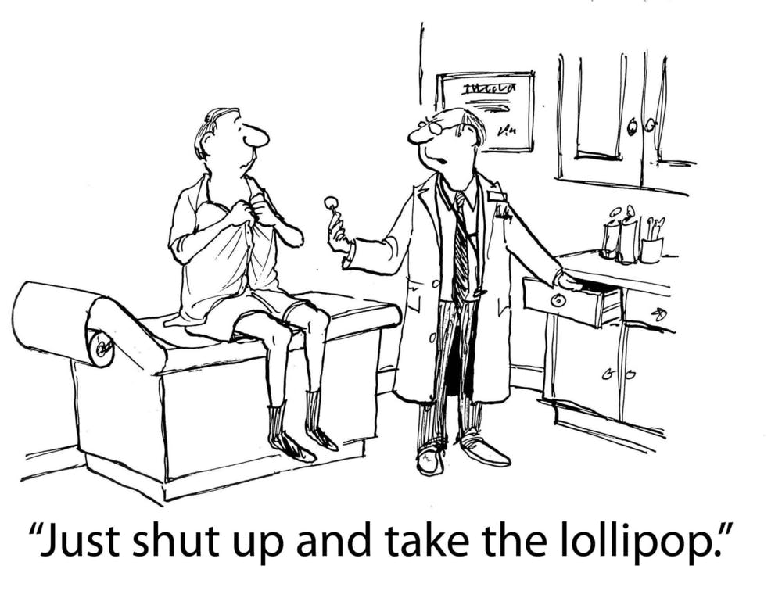
Bed side teaching manners

Slide 4
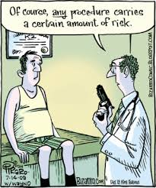
The teaching of bedside manners sets the stage for the many episodes of teaching clinical skills at the bedside.
This will make them better and more effective physicians during the years of their practice of medicine.
Effective communication with patients impacts clinical outcome and patient satisfaction.

Slide 5
6 communication elements:
- acknowledging the patient by name
- introducing themselves by name
- identifying their role
- explaining the care plan
- explaining that multiple providers would see the patient
- providing an estimated duration of time of treatment

Slide 6
A bedside teacher must learn how to involve patients and learners in the educational processes.
Specific aspects of bedside teaching should include history taking, physical examination, patient counselling, breaking bad news.
A planned activity is required to keep everyone engaged and involved in the teaching and learning.
Bedside is a place for positive learning, and not a place for pointed questioning or criticism of learners.
3 domains of best bedside beaching practices are
-attending to patient comfort
-focused teaching
-group dynamics.

Slide 7
Medical procedural teaching

Slide 8
Teaching a skill or proceedure
Teacher explains the proceedure – student understands it
Student explains the proceedure – Teacher corrects or adds inputs
Teacher performs while explaining –student observes
Clearing of doubts before performing the proceedure
Assisted performance by the student
Correction or adding inputs/feedbacks by the teacher
Assisted performance by the learner while explaining
Individual performance
Repeat proceedure
Teaching the proceedure ( reinforcement )

Slide 9
PROFESSIONALISM

Slide 10
Professional competence is the habitual and judicious use of communication, knowledge, technical skills, clinical reasoning, emotions, values, and reflection in daily practice for the benefit of the individual and community being served.

Slide 11
The attributes of a professional
Knowledge
Honesty
Specialized
Competency
Integrity
Accountability
Self-
Image
Regulation

Slide 12
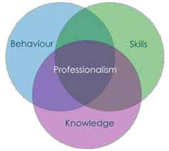
Attributes of Professionalism
Specialized Knowledge
Competency
Honesty and Integrity
Accountability
Self-Regulation
Image

Slide 13
Specialized Knowledge
Professionals make a deep personal commitment to develop and improve their skills.

Slide 14
Competency
Professionals get the job done.
Professionals are reliable.
Professionals keep their promises.
Professionals don’t make excuses, but focus on finding solutions.

Slide 15
Honesty and Integrity
Professionals don’t lie, cheat, or steal.
Professionals can be trusted.
Professionals don’t compromise their values.
Professionals will do the right thing even if it means taking a harder road.

Slide 16
Accountability
Professionals hold themselves accountable for their thoughts, words, and actions – especially when they’ve made a mistake.
Accountability is closely tied to honesty and integrity and is a vital element in professionalism.

Slide 17
Self-Regulation
Professionalism under pressure.
Professionals show respect for the people around them, no matter what their role or situation.
They exhibit a high degree of emotional intelligence by considering the emotions and needs of others.

Slide 18
IMAGE

Slide 19
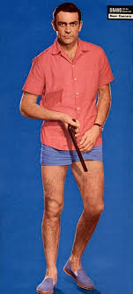
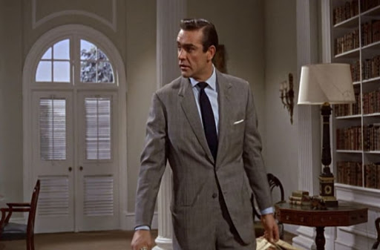
Dr. NO or DR.YES

Slide 20
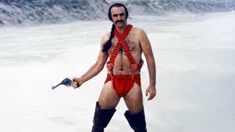

Slide 22
Professionals should look the part.
They don’t show up at work sloppily dressed, with unkempt hair.
They dress appropriately for the situation
Because of this, they exude an air of confidence and they gain respect for this.

Slide 23
Standards for Student Conduct
Demonstrate courtesy, even when others do not.
Behave in a responsible manner, always exercising discipline.
Attend all classes, regularly and on time.
Prepare for each class
Meet campus standards of grooming and dress.
Obey all campus and classroom rules.

Slide 24
Standards for Student Conduct
Respect the rights and privileges of other students, teachers, and other staff.
Respect the property of others and facilities.
Adhere to the requirements of the Code of Conduct.

Slide 25
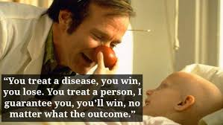
Thank you…..Have a great day

